Slide 1
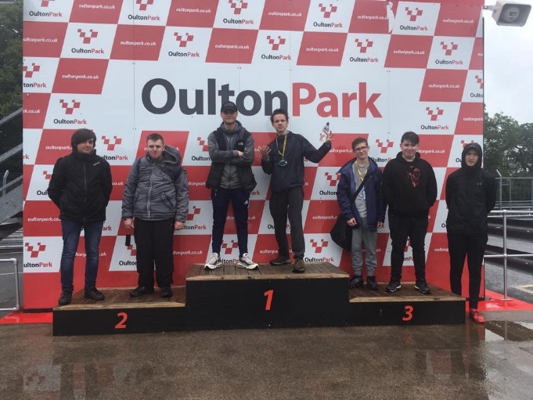
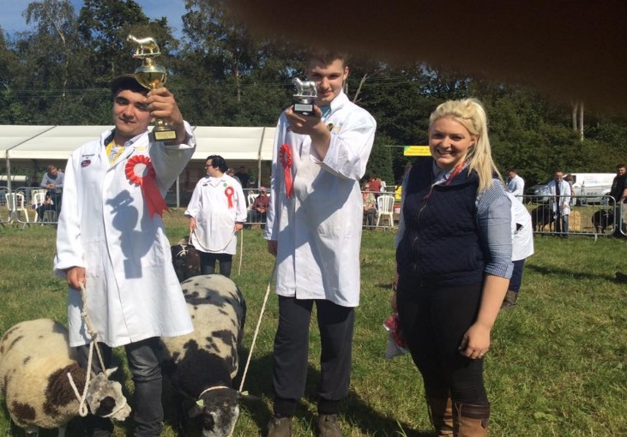
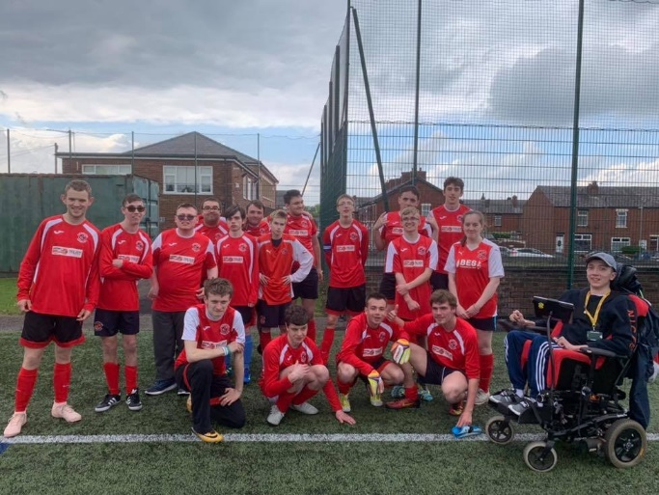
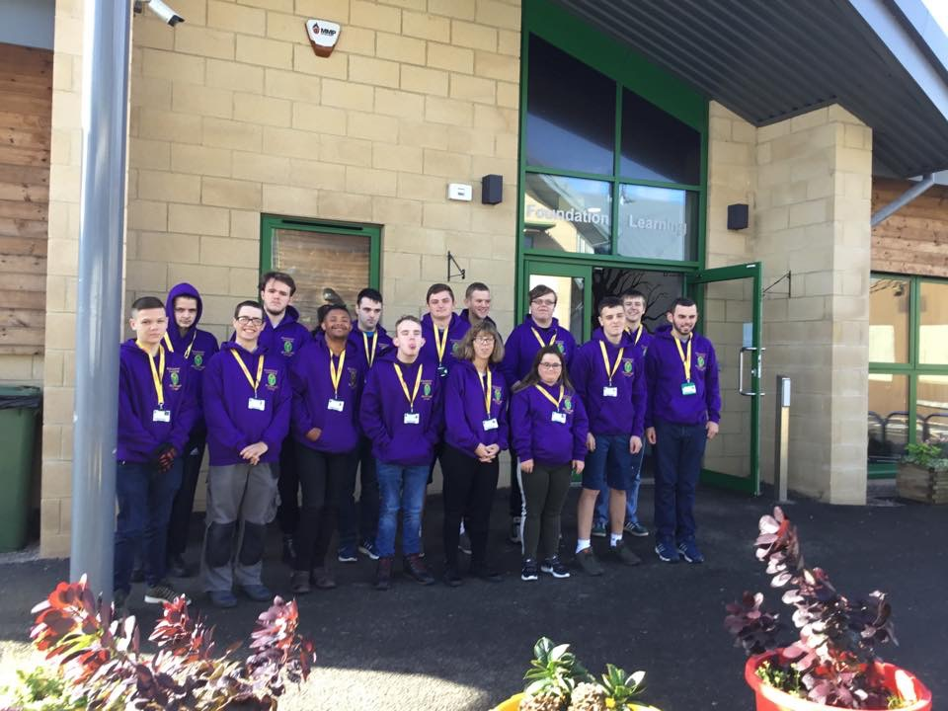
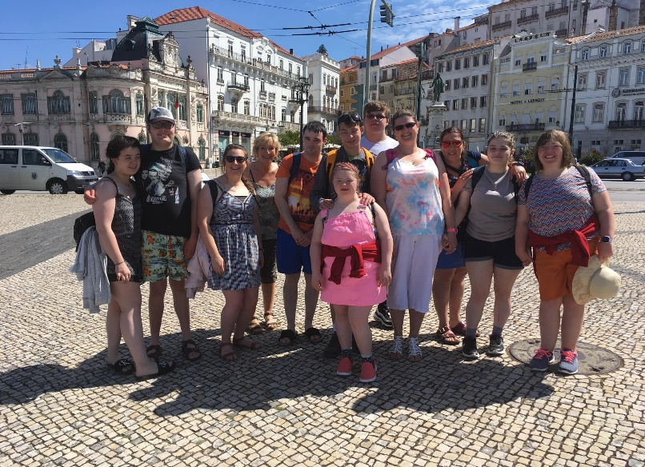
Foundation Learning 20/21
For further details please contact Barry Sherriff- Head of Foundation Learning – 01995 642222 or email bsherriff@myerscough.ac.uk
Course Enquiries Tel: 0800 652 5592

Slide 2
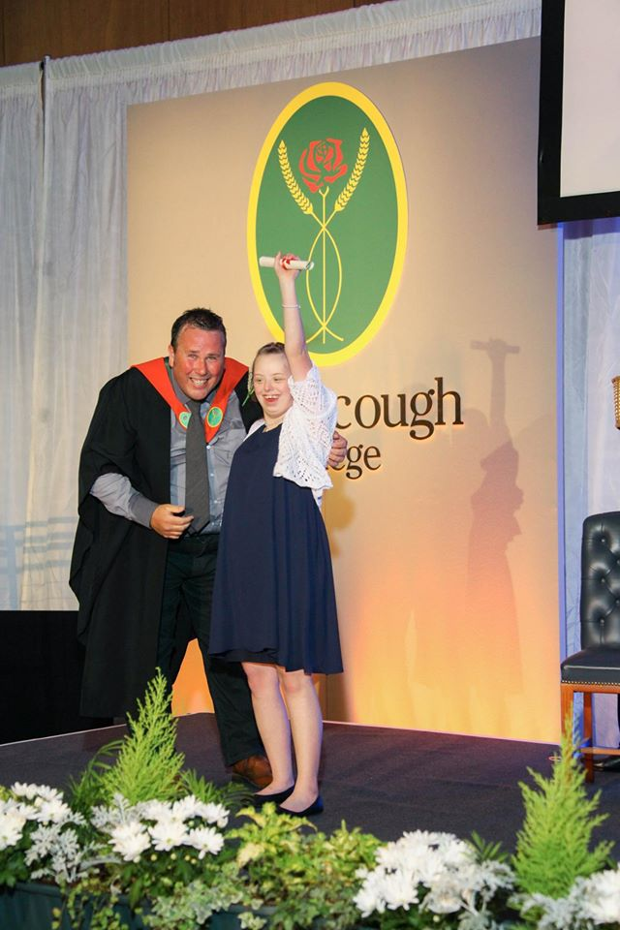
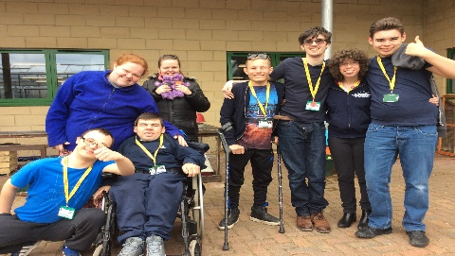
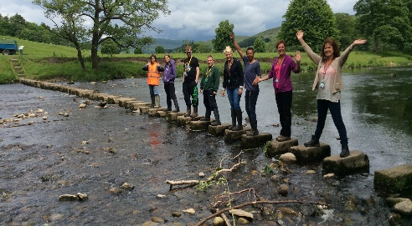
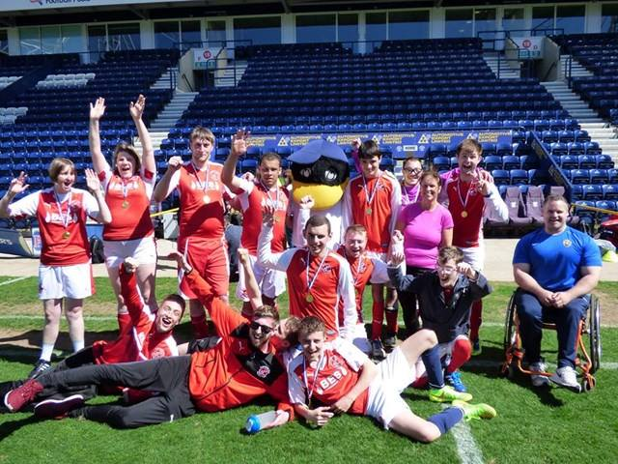
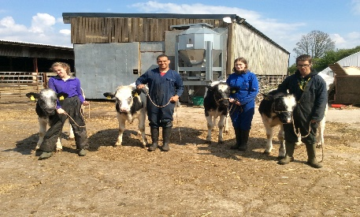
Why choose a Study Programme in Foundation Learning at Myerscough College?
A college with clear ‘Inclusive Values’ that encourages the SEND students at every opportunity to integrate within the overall college community and gain greater self-esteem, personal development and independence. This starts with a well planned programme of TRANSITION!
A well planned ‘curriculum’ offer that has strong intent, implementation and impact and allows clear progression and an opportunity to consider either a further learning programme or supported employment options.
A varied range of vocational options that include Animal Care, Agriculture, Horticulture, Motor Vehicle, Sport & Active Leisure and Public Services that enable the more practical learners to develop the relevant wider and employability skills.
A curriculum that has ‘Equality and Diversity’ embedded and offers excellent community involvement that enriches the learning experience. This is clearly linked to the ‘Preparation for Adulthood’ agenda.
A Study Programme that fully meets the key requirements of: a main qualification, English & maths and Work experience/ Enrichment underpinned with an excellent personal & course tutorial system.
Realistic group sizes that provide an excellent supported learning environment where students feel safe and secure throughout all their time at college.

Slide 3
A Vision for Excellence in Teaching Learning & Assessment FOUNDATION LEARNING
The Foundation Learning Department of Myerscough College aims to be known locally and regionally as a ‘Centre of Excellence’ and at the forefront of Teaching & Learning for Study Programmes from Entry Level 1 - Level 1 for SEND learners. We strive for all learners to maximise their potential, both educationally and socially by motivating and engaging learners in a safe and inclusive environment.
What does this mean and what does it look like?
A motivated and dynamic team working together to provide the highest level of Teaching & Learning in order to achieve success for all learners.
Teaching staff who are qualified both professionally and vocationally working closely with Inclusive Learning staff and external agencies to support all learners to achieve their potential including those identified as High Need funded learners.
An embedded ethos of individualised learning where the abilities and needs of all learners are rigorously assessed during induction and regularly throughout the course to inform and support lesson planning .
Staff with a keen desire to Continuous Professional Development to enhance their craft both professionally and in their vocational area of expertise.
A team recognised by external examining bodies and external verifiers as practitioners of best practice and the highest quality.
A team approach to marketing and external promotion ensuring Myerscough is the college of choice for Foundation Learning leading to structured and controlled development of the department. We are aspiring to become ‘outstanding’ by Ofsted under the ‘new’ Education Inspection Framework.
Excellent practical and theory resources conducive to engaging and motivating learners.
A commitment to setting challenging targets for all learners to support them in achieving the highest level of success possible. This is linked to the EHCP wherever appropriate.
A strong desire to empower and develop young people leading to a range of appropriate destinations such as further education, supported employment or independent living.
An integrated cross college approach to Foundation Learning where the journey is led by the learners’ interests and ambitions.
A curriculum comprising of individualised learning programmes based on an initial assessment which identifies prior achievements, educational, personal development and social needs and future aspirations that are all linked to ‘Preparation for Adulthood’.
A curriculum offer that is underpinned by strong ‘British Values’ that help the learners understand their role and contribution to their local community and society in general.

Slide 4
What’s on offer for 20/21?
Course | Accreditation
EL1 ASDAN Personal Progress | Award/Certificate/Diploma
EL2 ASDAN Personal Social Development | Award/Certificate
EL3 ASDAN Personal Social Development | Certificate
EL2 Skills for Working Life (Animal Care, Agriculture & Horticulture) | Award/Certificate/Diploma
EL3 Skills for Working Life (Animal Care, Agriculture & Horticulture) | Award/Certificate/Diploma
L1 ABC Practical Countryside Skills (Agriculture) | Certificate
L1 ABC Practical Countryside Skills (Animal Care) | Certificate
L1 ABC Practical Countryside Skills (Horticulture) | Certificate
L1 ABC Motor Vehicle Studies | Diploma
L1 BTEC Sport & Active Leisure | Award/Certificate/Diploma
L1 BTEC Public Services | Introductory Diploma
EL3 City & Guilds Employability Skills (Foundation Supported Internship) - Work experience programme aimed at becoming ‘job ready’ including programme of supported and voluntary placements. | Certificate
L1 City & Guilds Employability Skills (Intermediate Supported Internship) - Work experience programme aimed at becoming ‘job ready’ focusing on social enterprise and internal placements. | Certificate
L2 City & Guilds Employability Skills (Advanced Supported Internship) - Work experience programme aimed at becoming ‘job ready’ focusing on project work and external placements. | Award

