Slide 1
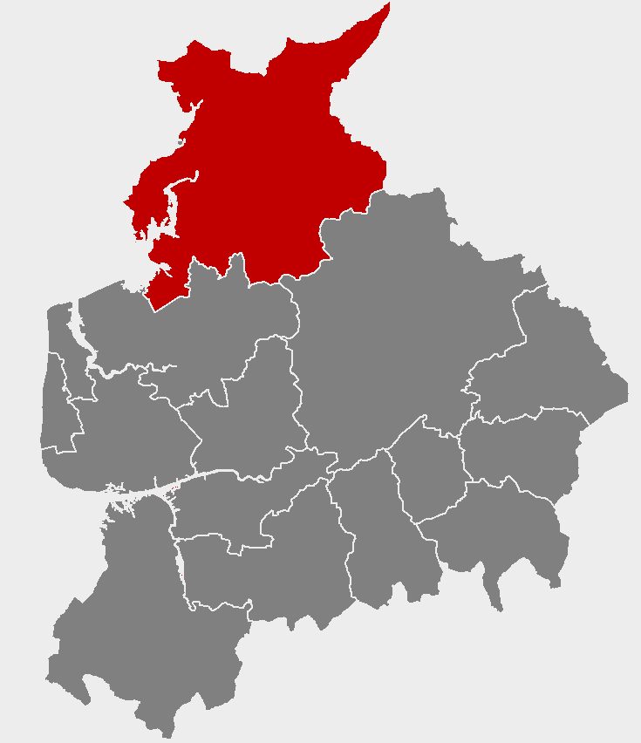
Work and job opportunities in your area
Notes:
*****PLEASE READ*****
1) This slideshow is for PRESENTATION USE only. Please do not use these slides for print out/ hard copy as some of the slides will not make sense.
2) Do not edit the content or animations on each of the slides, as this will affect the timings of the presentation. If you need to make the presentation shorter, removing whole slides will allow for the presentation to remain aligned with the animations and transitions.
3) The music will only play if the presentation is started from the first slide. Please avoid stopping and resuming the presentation, as this will result in a silent slideshow.
4) For any queries, please contact LancsSkillsHub@lancashirelep.co.uk

Slide 3
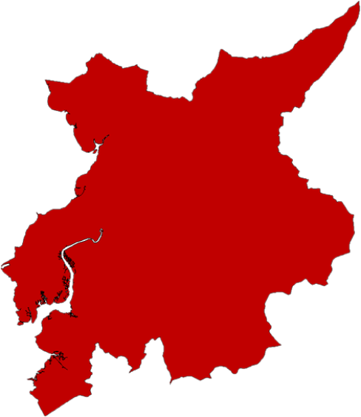
What do you know about the jobs in your local area?
Carnforth
Morecambe
Lancaster
Heysham
Bailrigg

Slide 4
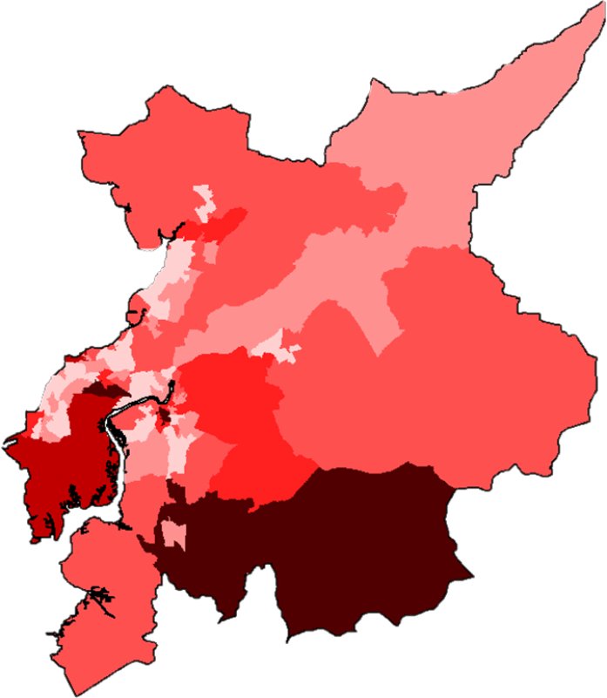
There are 58,000 jobs across the area
South Lakeland
3,050
Around 1 in 5 people work outside the area
Carnforth
Morecambe
White Lund Industrial Estate
Preston
1,660
Lancaster
Heysham
Bailrigg
The darker the colour, the more people are employed
Lancaster University
Fylde
540
Wyre
1,040

Slide 5
An overview of your area
4,660
8,100
Are self-employed
Number of businesses
2,800
Are unemployed
66,800
People in work
Two-fifths of people have gone onto higher education

Slide 6
The top five industries with the most jobs are:
9,000 JOBS
Education
9,000 JOBS
Health and Social Care
8,000 JOBS
Financial and Professional Sector
£
7,000 JOBS
Retail (including motor trade)
6,000 JOBS
Visitor Economy

Slide 7
What are some of the businesses in these sectors?
9,000 JOBS
Education
9,000 JOBS
Health and Social Care
8,000 JOBS
Financial and Professional Sector
£
7,000 JOBS
Retail (including motor trade)
6,000 JOBS
Visitor Economy

Slide 8
There are some well known large businesses, but most employ fewer than 10 people
15
Are large businesses
(Employing 250+ people)
80
Are medium-sized businesses
(Employing 50 to 249 people)
445
Are small businesses
(Employing 10-49 people)
4,120
Are micro businesses
(Employing 0-9 people)

Slide 9
Where are key employers based in your area?
Holgates
AXA Insurance
SWS Shutters UK
ICT Reverse
Carnforth
Diamond Resorts
Morecambe
GVS Filters
The Network People
Alfa Aesar
Lancaster
Elis
EDF Energy
Heysham
First Subsea
Bailrigg
English Lakes
Metamark
Lancaster University
NuBlue
University of Cumbria

Slide 10
Local employers will need to recruit over 6,700 workers each year over the next decade to meet sector growth and replace those leaving their jobs
£
1,100 JOBS
Financial and Professional Sector
900 JOBS
Health and Social Care
900 JOBS
Wholesale and Retail
900 JOBS
Education
900 JOBS
Visitor Economy
500 JOBS
Creative and Digital
400 JOBS
Construction
200 JOBS
Manufacturing

Slide 11
The skills that are highly desired by local employers are:
Time management
Teamwork
Communication
Digital skills
Initiative
Critical thinking and problem solving

Slide 12
Over the next 10 years businesses will be looking for employees with higher qualifications
1,030 JOBS
Level 4 Degree HND / HNC / NVQ 4
890 JOBS
Level 3 A & AS Level / NVQ 3
-360 JOBS
Level 2 GCSE 9-4 /NVQ 1
-160 JOBS
Level 1 GCSE 3-1 NVQ 1
-240 JOBS
No qualifications
In addition, 940 jobs per year are expected to require other qualifications, including apprenticeships, for which the level is not specified

Slide 13
The higher the qualifications you have, the more you can earn
£757 per week
£531 per week
£513 per week
£511 per week
£413 per week
No qualifications
Level 1 GCSE 3-1 NVQ 1
Level 2 GCSE 9-4 /NVQ 1
Level 3 A & AS Level / NVQ 3
Level 4 Degree HND / HNC / NVQ 4
Figures reflect average earnings by highest qualifications held, at the national level.
Notes:
Source: Careers Online - Weekly Earnings by Qualification, 2019
These figures are national (rather than local) evidence, reflecting limits on data availability

Slide 14
Living in your area is cheaper than other areas of England
£240,000
£150,000
£153,000
Lancashire
Lancaster and Morecambe
England
With cheaper house prices across your area, you will be able to save for a house quicker than other areas of England

Slide 15
7,750 residents of your area are participating in Further Education (FE)
Data for local FE providers shows…
3%
Attend Other Public Funded Institutions
(Local Authorities and Higher Education)
1%
Attend Private Sector Funded Institutions
22%
Attend Schools
75%
Attend General FE College
FE students tend to be older in your area compared to the rest of England.
Figures may not sum due to rounding.
Notes:
Due to data limitations, the analysis of the student age profile relates to FE provision that is ESFA-funded and captured in Individualised Learner Record returns only. This excludes school sixth form provision which accounts for 1,366 learners

Slide 16
There are lots of options for young people finishing education at age 18
61%
Carry on in education
Of which…
52%
6%
3%
Go to university
Into other types of education
Go to college
83%
In sustained education or employment
22%
Go into employment
7%
Of which do an apprenticeship

Slide 17
1,140
People in your area started an apprenticeship in 2018/19
290 Were under the age of 19 and 830 were over the age of 19
The most popular subject areas are:
£
310
Business, Administration and Law
250
Health, Public Services and Care
210
Engineering and Manufacturing
160
Retail and Commercial Enterprise
90
Construction, Planning and the Built Environment
40
Education and Training
Figures do not sum due to rounding.

Slide 18
Advanced and higher levels account for 40% of under 19 apprenticeships
and
73% of over 19 apprenticeships in your area

Slide 19
For more information
Insert link to the LMI Reports online

