Slide 1
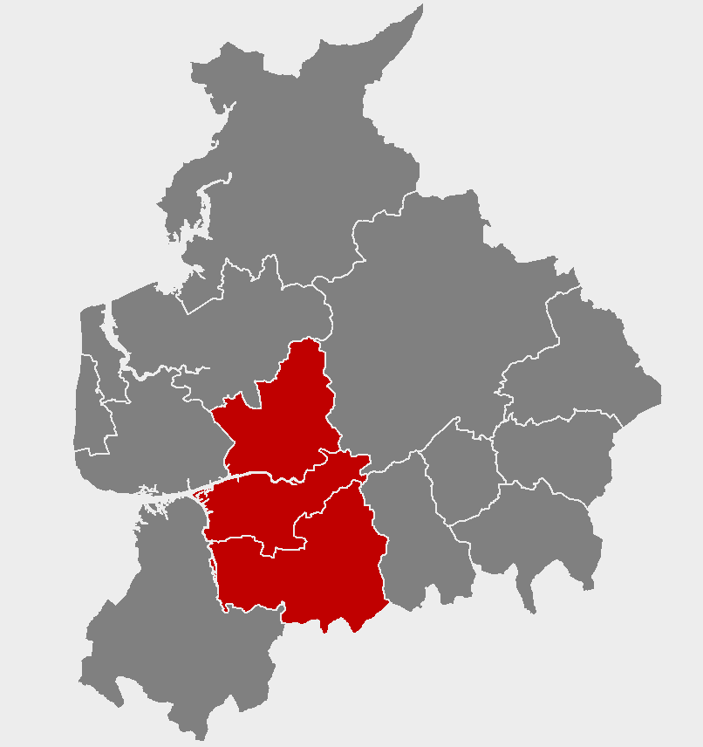
Work and job opportunities in your area
Notes:
*****PLEASE READ*****
1) This slideshow is for PRESENTATION USE only. Please do not use these slides for print out/ hard copy as some of the slides will not make sense.
2) Do not edit the content or animations on each of the slides, as this will affect the timings of the presentation. If you need to make the presentation shorter, removing whole slides will allow for the presentation to remain aligned with the animations and transitions.
3) The music will only play if the presentation is started from the first slide. Please avoid stopping and resuming the presentation, as this will result in a silent slideshow.
4) For any queries, please contact LancsSkillsHub@lancashirelep.co.uk

Slide 3
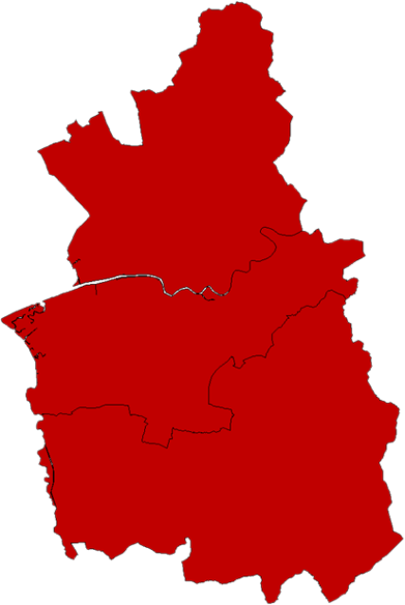
What do you know about the jobs in your local area?
Preston
Leyland
Chorley

Slide 4
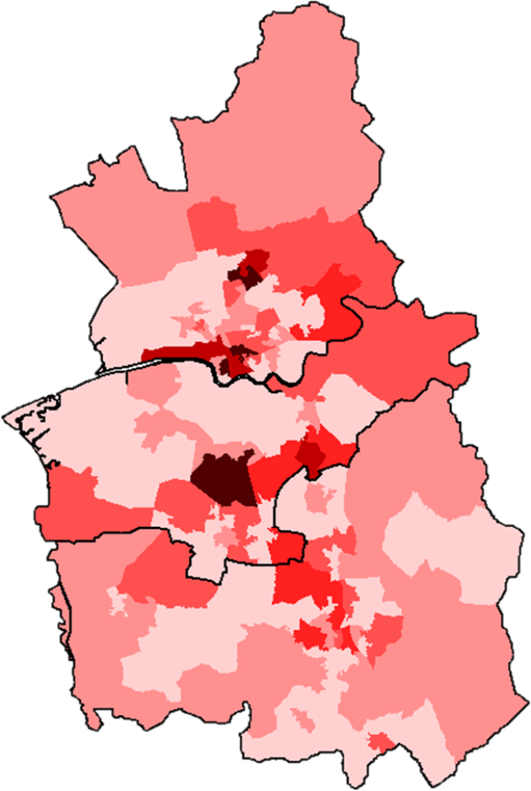
There are 186,000 jobs across the area
Royal Preston Hospital
Ribble Valley
3,830
Over 1 in 4 people work outside the area
Fylde
6,250
Preston
Samlesbury Aerodrome
Blackburn with Darwen
3,550
Lancashire and Leyland Business Parks
Leyland
The darker the colour, the more people are employed
Matrix Industrial Park and Buckshaw Village
Chorley
Wigan
2,800
Bolton
3,590

Slide 5
An overview of your area
13,630
17,100
Are self-employed
Number of businesses
6,000
Are unemployed
189,200
People in work
Over two-fifths of people have gone onto higher education

Slide 6
The top five industries with the most jobs are:
£
29,000 JOBS
Financial and Professional Sector
26,000 JOBS
Health and Social Care
22,000 JOBS
Retail (including motor trade)
18,000 JOBS
Construction
18,000 JOBS
Administration and Support

Slide 7
What are some of the businesses in these sectors?
£
29,000 JOBS
Financial and Professional Sector
26,000 JOBS
Health and Social Care
22,000 JOBS
Retail (including motor trade)
18,000 JOBS
Construction
18,000 JOBS
Administration and Support

Slide 8
There are some well known large businesses, but most employ fewer than 10 people
60
Are large businesses
(Employing 250+ people)
235
Are medium-sized businesses
(Employing 50 to 249 people)
1,365
Are small businesses
(Employing 10-49 people)
11,965
Are micro businesses
(Employing 0-9 people)

Slide 9
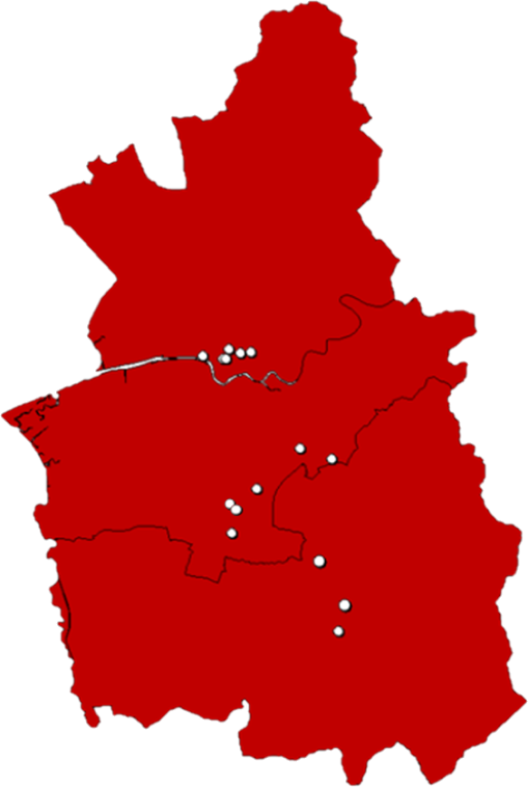
Where are key employers based in your area?
Royal Preston Hospital
Lancashire Fire and Rescue
Preston College
BAE Systems
Preston City Council
UCLan
CEC
Preston
Lancashire County Council
Baxi Heating UK Limited
Jones Lighting
Leyland
Doctor Oetker
Lancashire Care
Amazon
Chorley
Kimberly Clark
South Ribble Council
Crowberry Consulting
Chorley and South Ribble Hospital

Slide 10
Local employers will need to recruit over 17,100 workers each year over the next decade to meet sector growth and replace those leaving their jobs
£
3,800 JOBS
Financial and Professional Sector
2,800 JOBS
Wholesale and Retail
2,000 JOBS
Health and Social Care
1,400 JOBS
Construction
1,300 JOBS
Visitor Economy
1,300 JOBS
Creative and Digital
900 JOBS
Education
600 JOBS
Manufacturing

Slide 11
The skills that are highly desired by local employers are:
Time management
Teamwork
Communication
Digital skills
Initiative
Critical thinking and problem solving

Slide 12
Over the next 10 years businesses will be looking for employees with higher qualifications
3,630 JOBS
Level 4 Degree HND / HNC / NVQ 4
2,620 JOBS
Level 3 A & AS Level / NVQ 3
-810 JOBS
Level 2 GCSE 9-4 /NVQ 1
-320 JOBS
Level 1 GCSE 3-1 NVQ 1
-690 JOBS
No qualifications
In addition, 3,210 jobs per year are expected to require other qualifications, including apprenticeships, for which the level is not specified

Slide 13
The higher the qualifications you have, the more you can earn
£757 per week
£531 per week
£513 per week
£511 per week
£413 per week
No qualifications
Level 1 GCSE 3-1 NVQ 1
Level 2 GCSE 9-4 /NVQ 1
Level 3 A & AS Level / NVQ 3
Level 4 Degree HND / HNC / NVQ 4
Figures reflect average earnings by highest qualifications held, at the national level.
Notes:
Source: Careers Online - Weekly Earnings by Qualification, 2019
These figures are national (rather than local) evidence, reflecting limits on data availability

Slide 14
Living in your area is cheaper than other areas of England
£165,000
£165,000
£240,000
£142,500
£150,000
Preston
Lancashire
Chorley
South Ribble
England
With cheaper house prices across your area, you will be able to save for a house quicker than other areas of England

Slide 15
25,370 residents of your area are participating in Further Education (FE)
Data for local FE providers shows…
4%
Attend Other Public Funded Institutions
(Local Authorities and Higher Education)
1%
Attend Schools
16%
Attend Sixth Form College
56%
Attend General FE College
23%
Attend Private Sector Funded Institutions
FE students tend to be younger in your area compared to the rest of England.
Figures may not sum due to rounding.
Notes:
Due to data limitations, the analysis of the student age profile relates to FE provision that is ESFA-funded and captured in Individualised Learner Record returns only. This excludes school sixth form provision which accounts for 287 learners

Slide 16
There are lots of options for young people finishing education at age 18
64%
Carry on in education
Of which…
56%
6%
2%
Go to university
Go to college
Into other types of education
82%
In sustained education or employment
18%
Go into employment
9%
Of which do an apprenticeship

Slide 17
3,490
People in your area started an apprenticeship in 2018/19
860 Were under the age of 19 and 2,630 were over the age of 19
The most popular subject areas are:
£
1,200
Business, Administration and Law
960
Health, Public Services and Care
500
Engineering and Manufacturing
370
Retail and Commercial Enterprise
200
Construction, Planning and the Built Environment
130
Information and Communication
Figures do not sum due to rounding.

Slide 18
Advanced and higher levels account for 47% of under 19 apprenticeships
and
73% of over 19 apprenticeships in your area

Slide 19
For more information
Insert link to the LMI Reports online

